Slide 1
Pairwise DE analysis
1 hr
Enzymes:
1 peptidase
151 DEGs 71 upregulated in no prey
103 upregulated in prey
Enzymes: 1 chitinase, 1 lipase, 1 peroxidase,
1 protease, 4 phosphatases, 3 peptidases
24 hr
Enzymes:
1 lipase,
3 phosphatases
151 DEGs 2 upregulated in no prey
149 upregulated in prey

Slide 2
1 hr GO Term Classifications
24 hr GO Term Classifications – 126 genes total

Slide 3
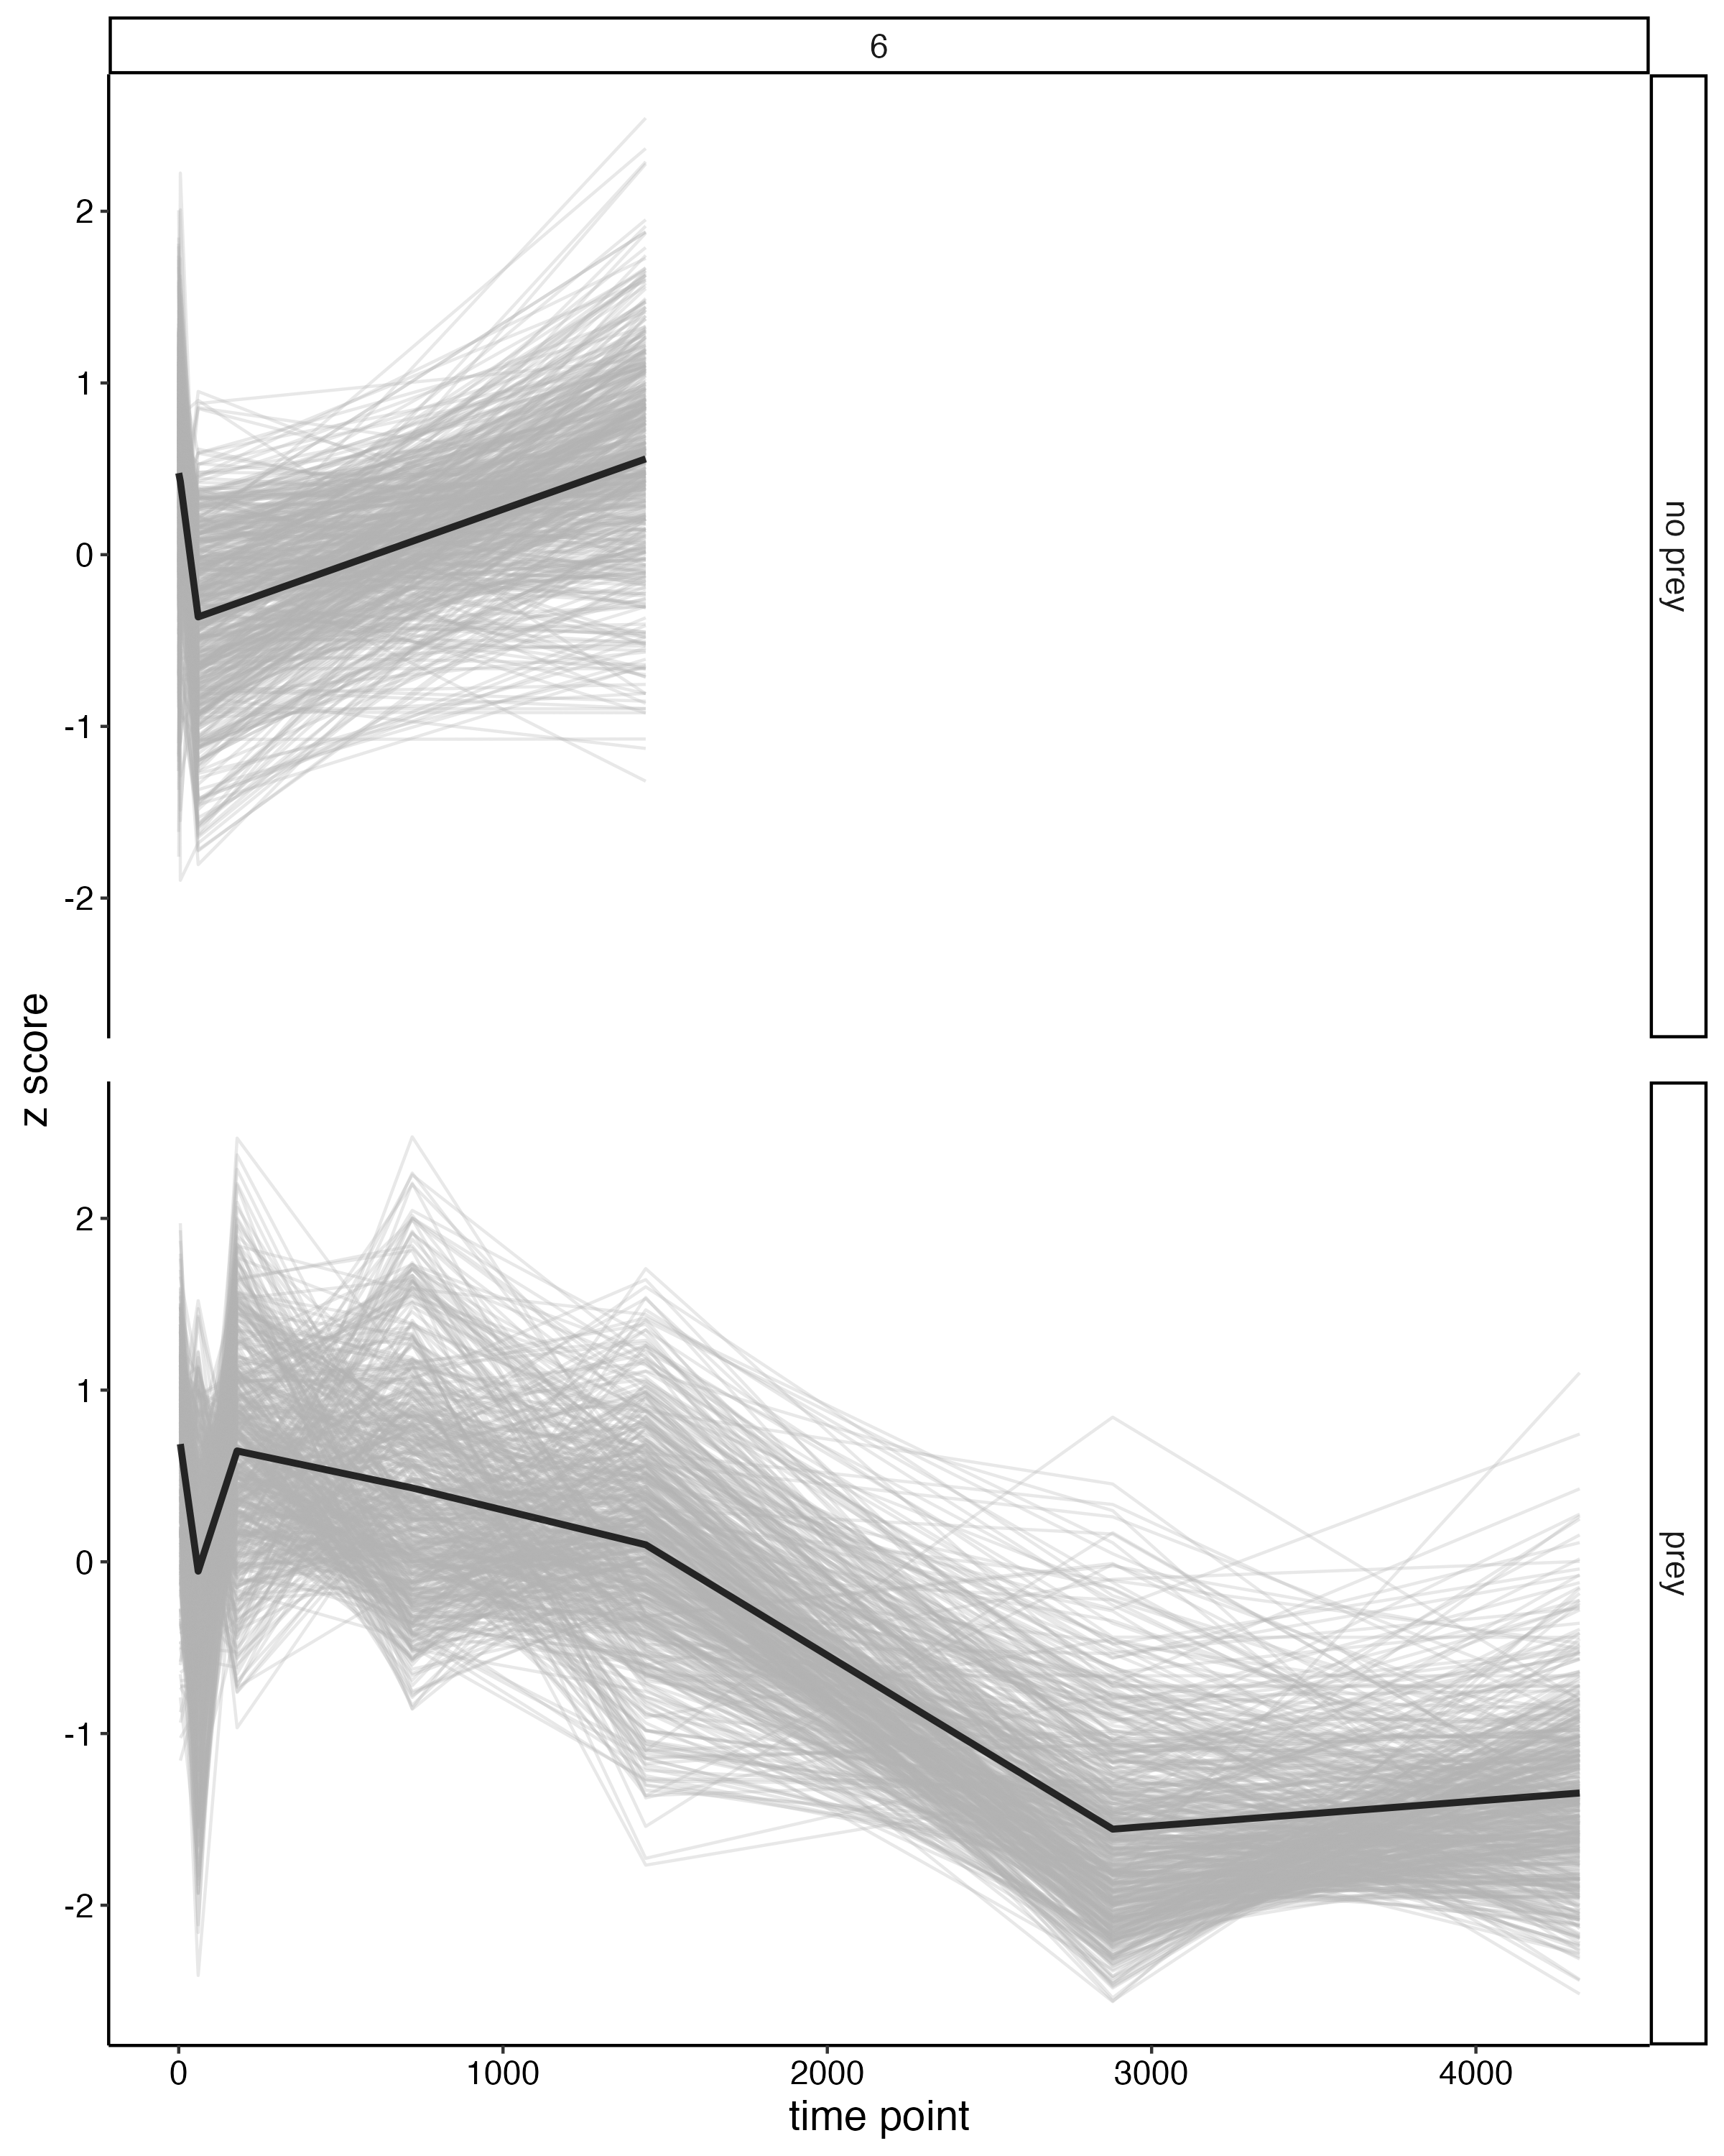
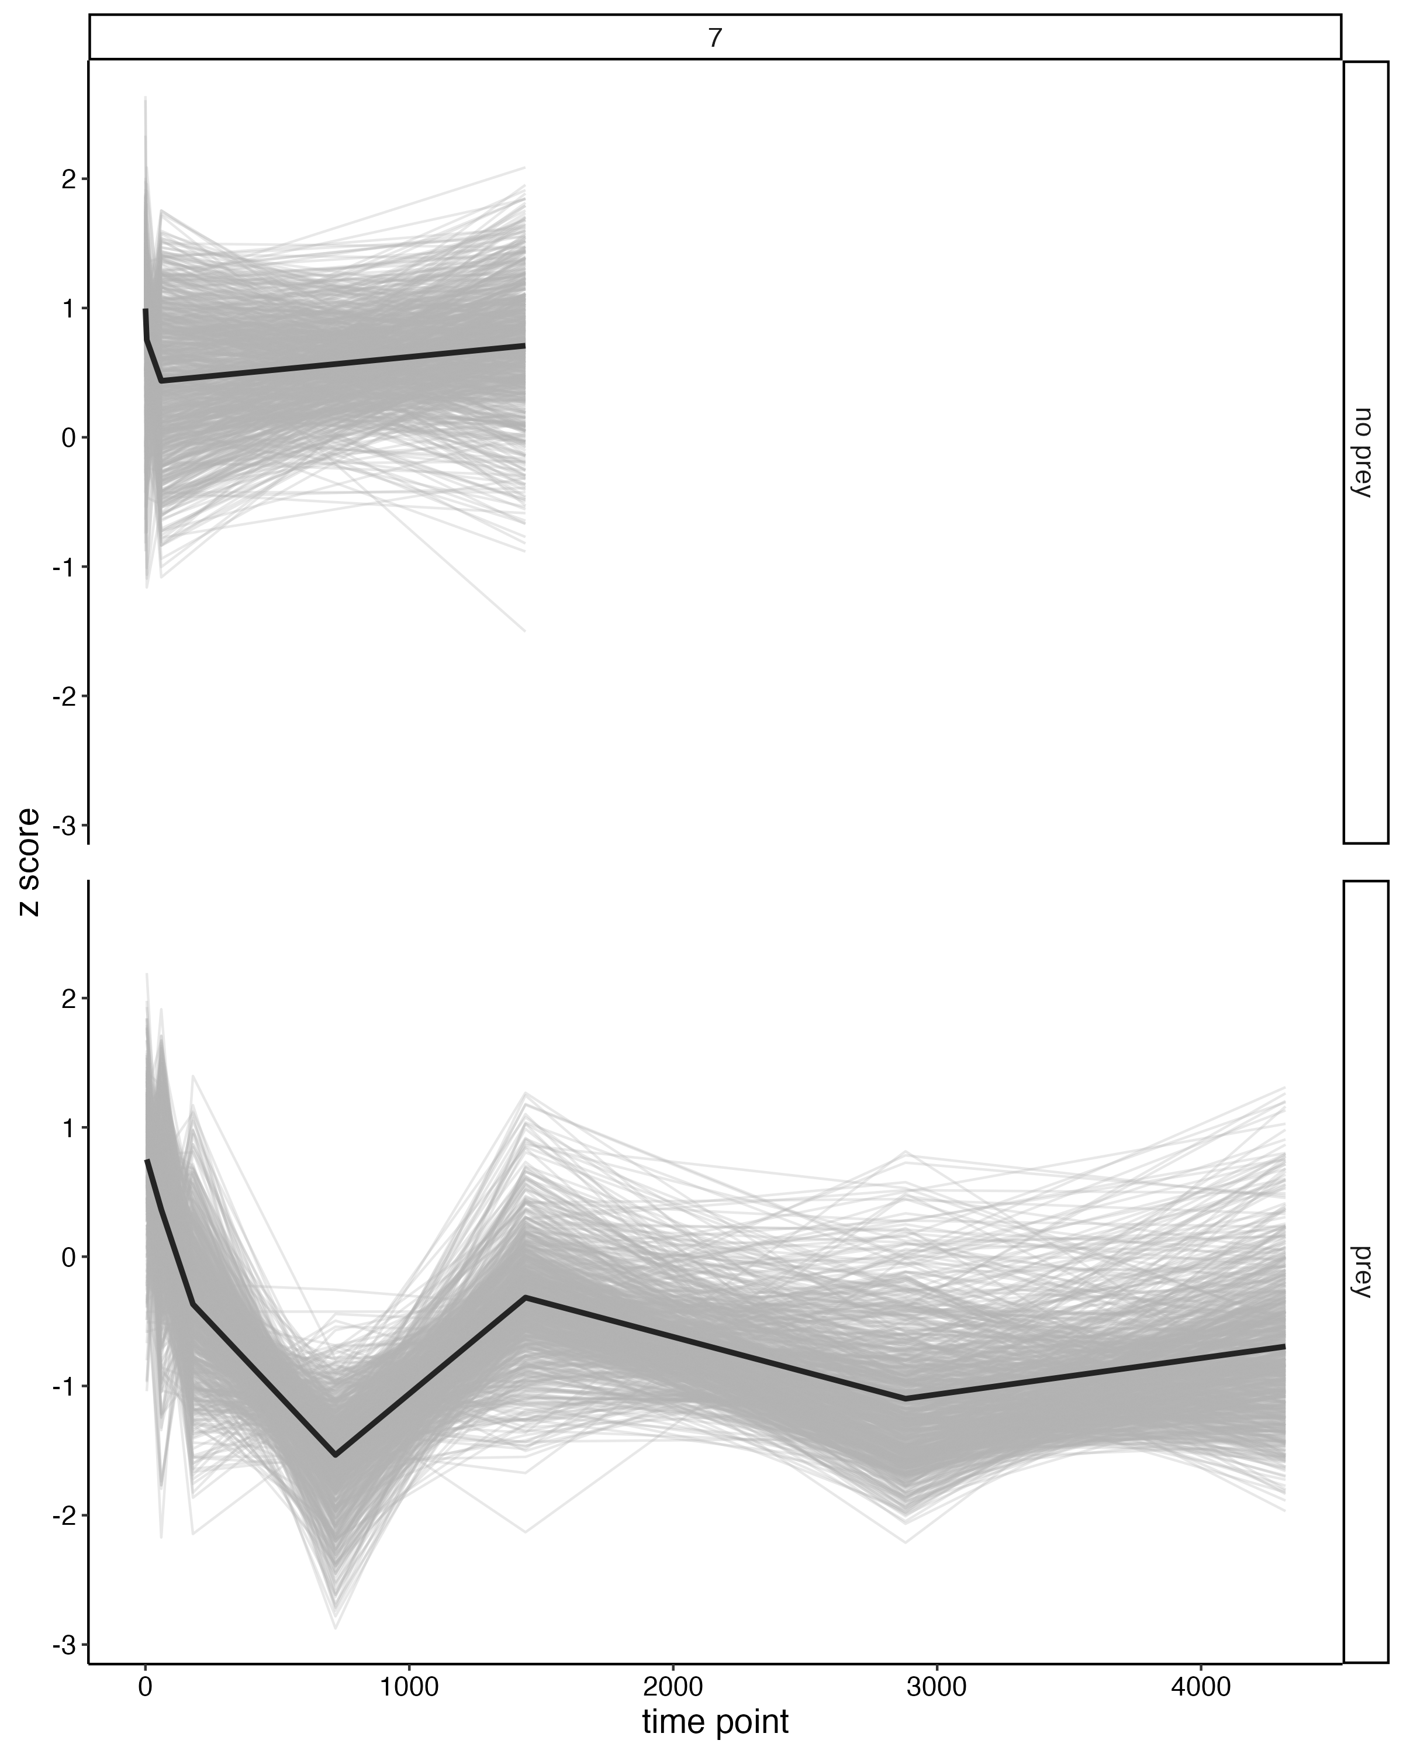
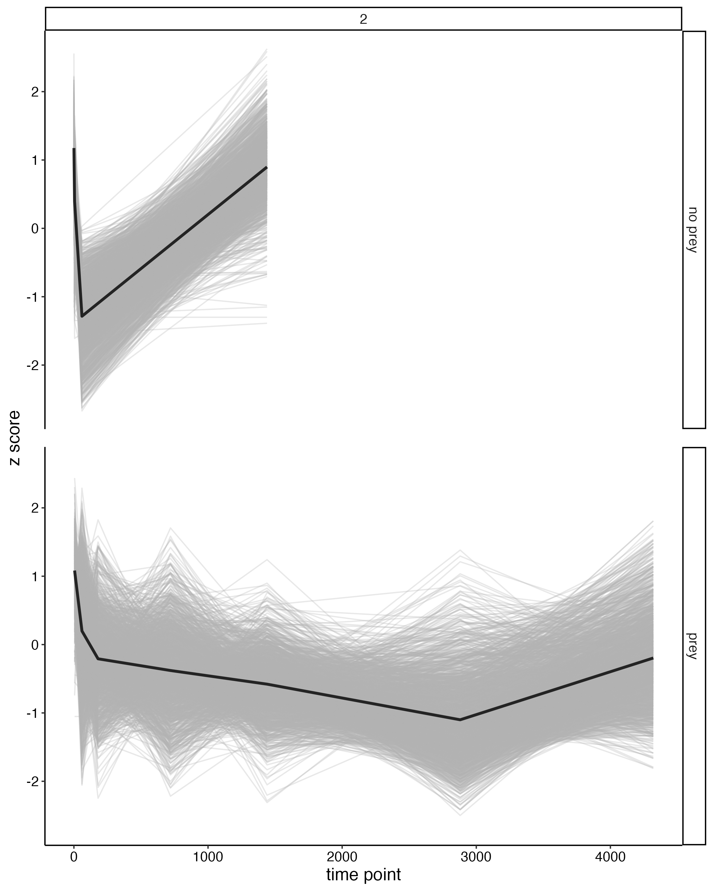
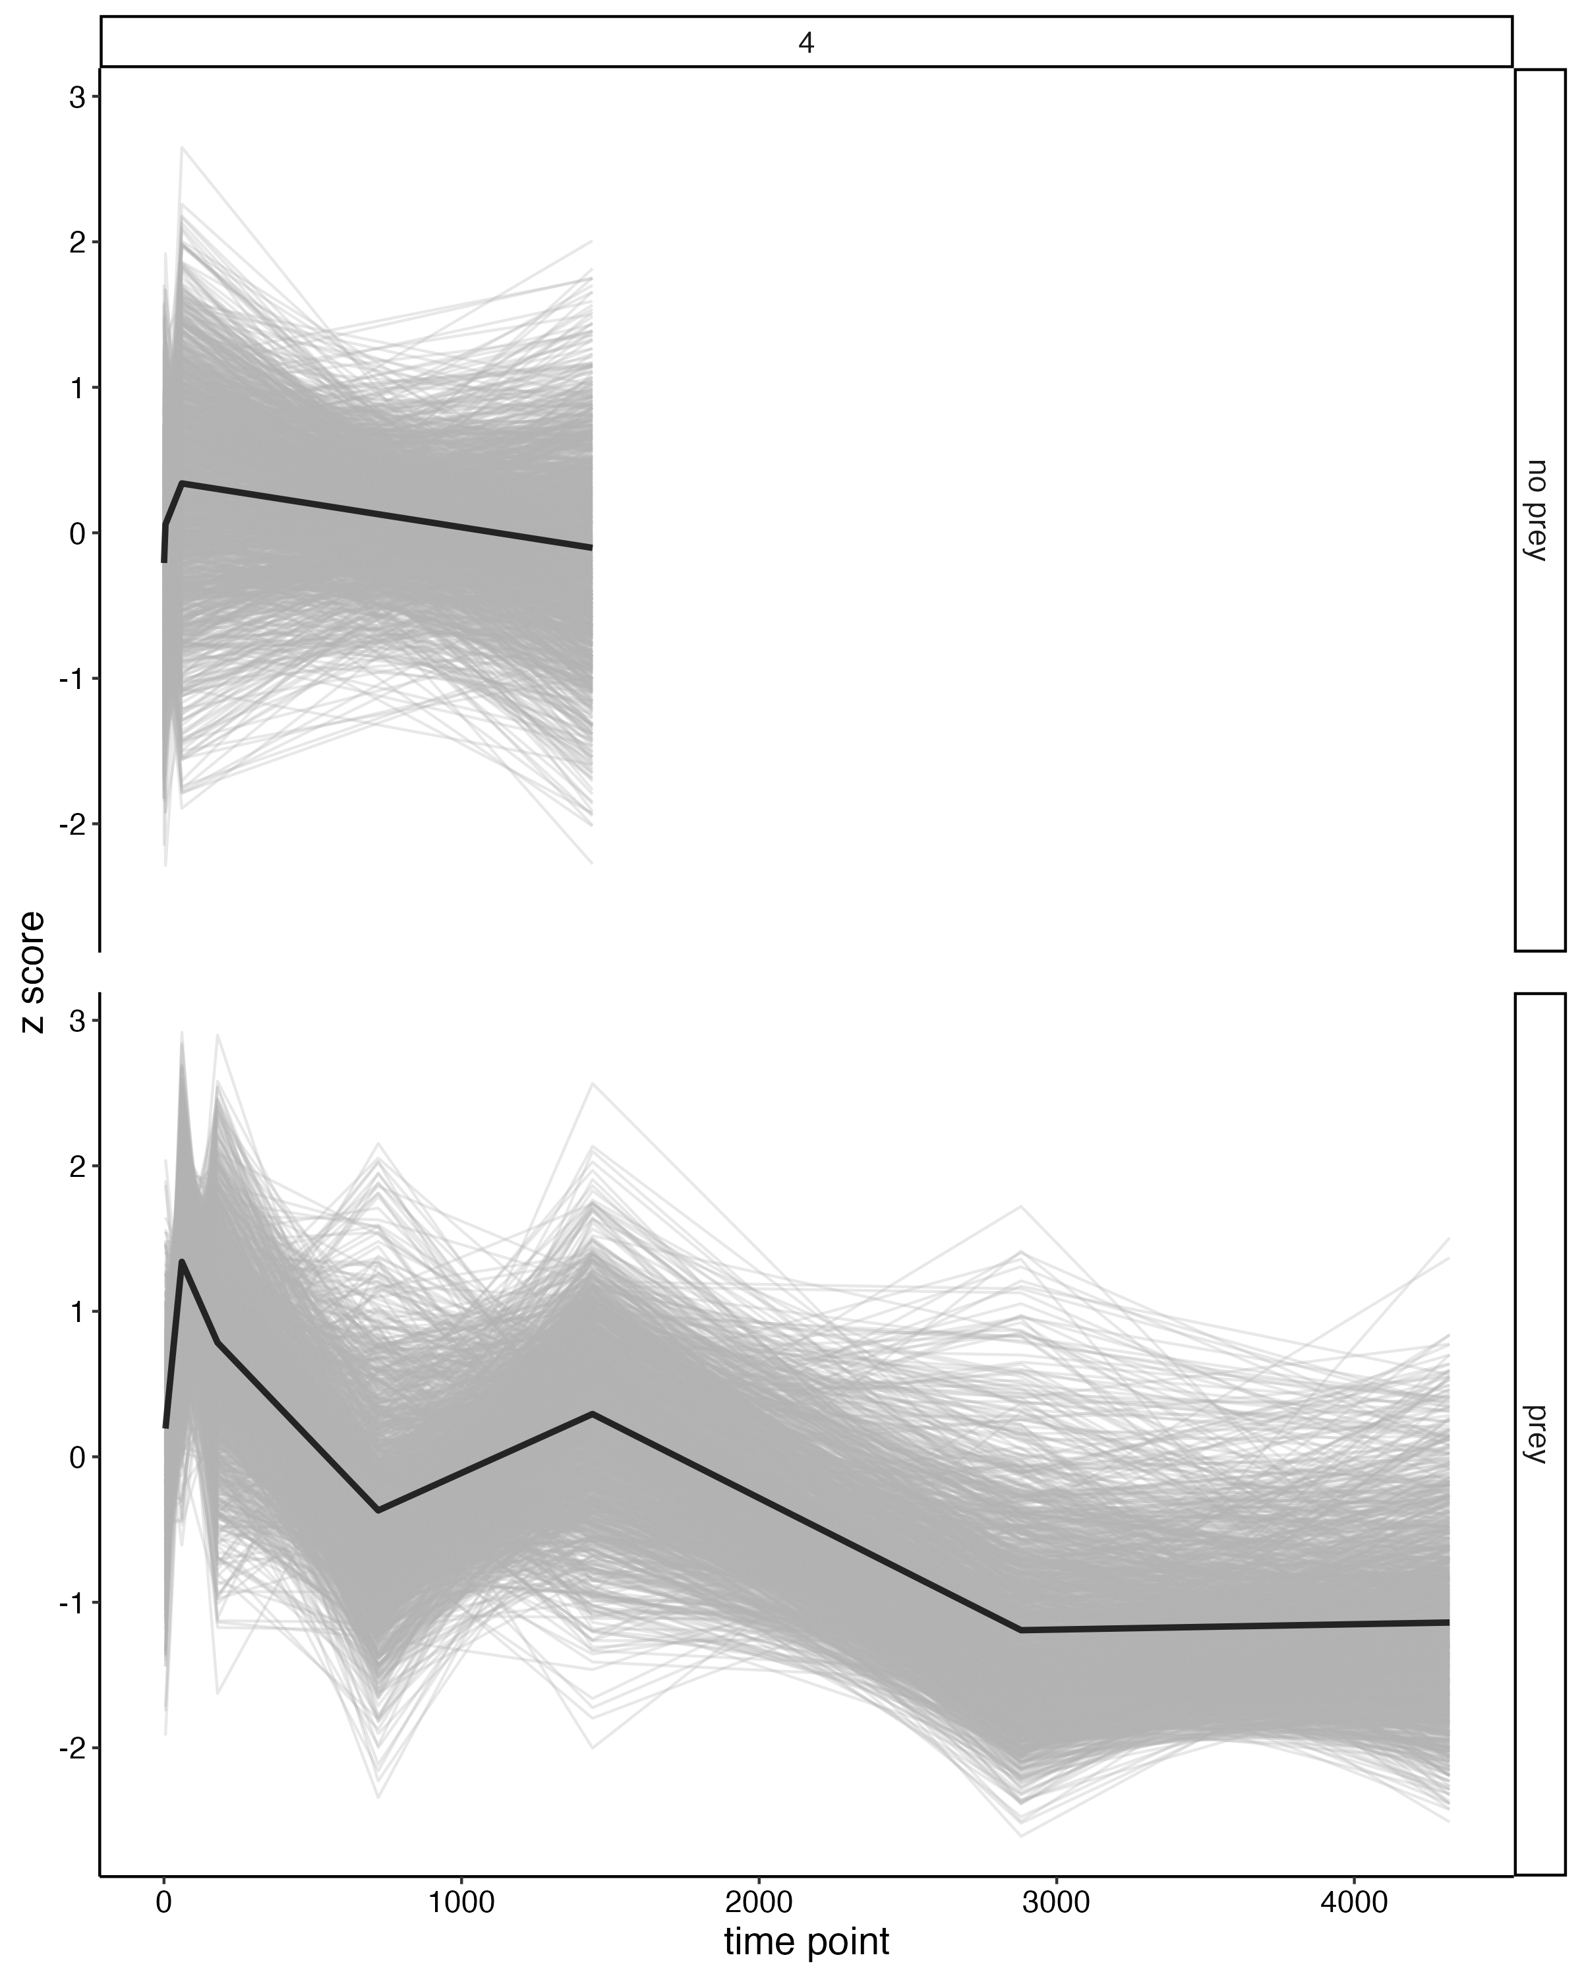
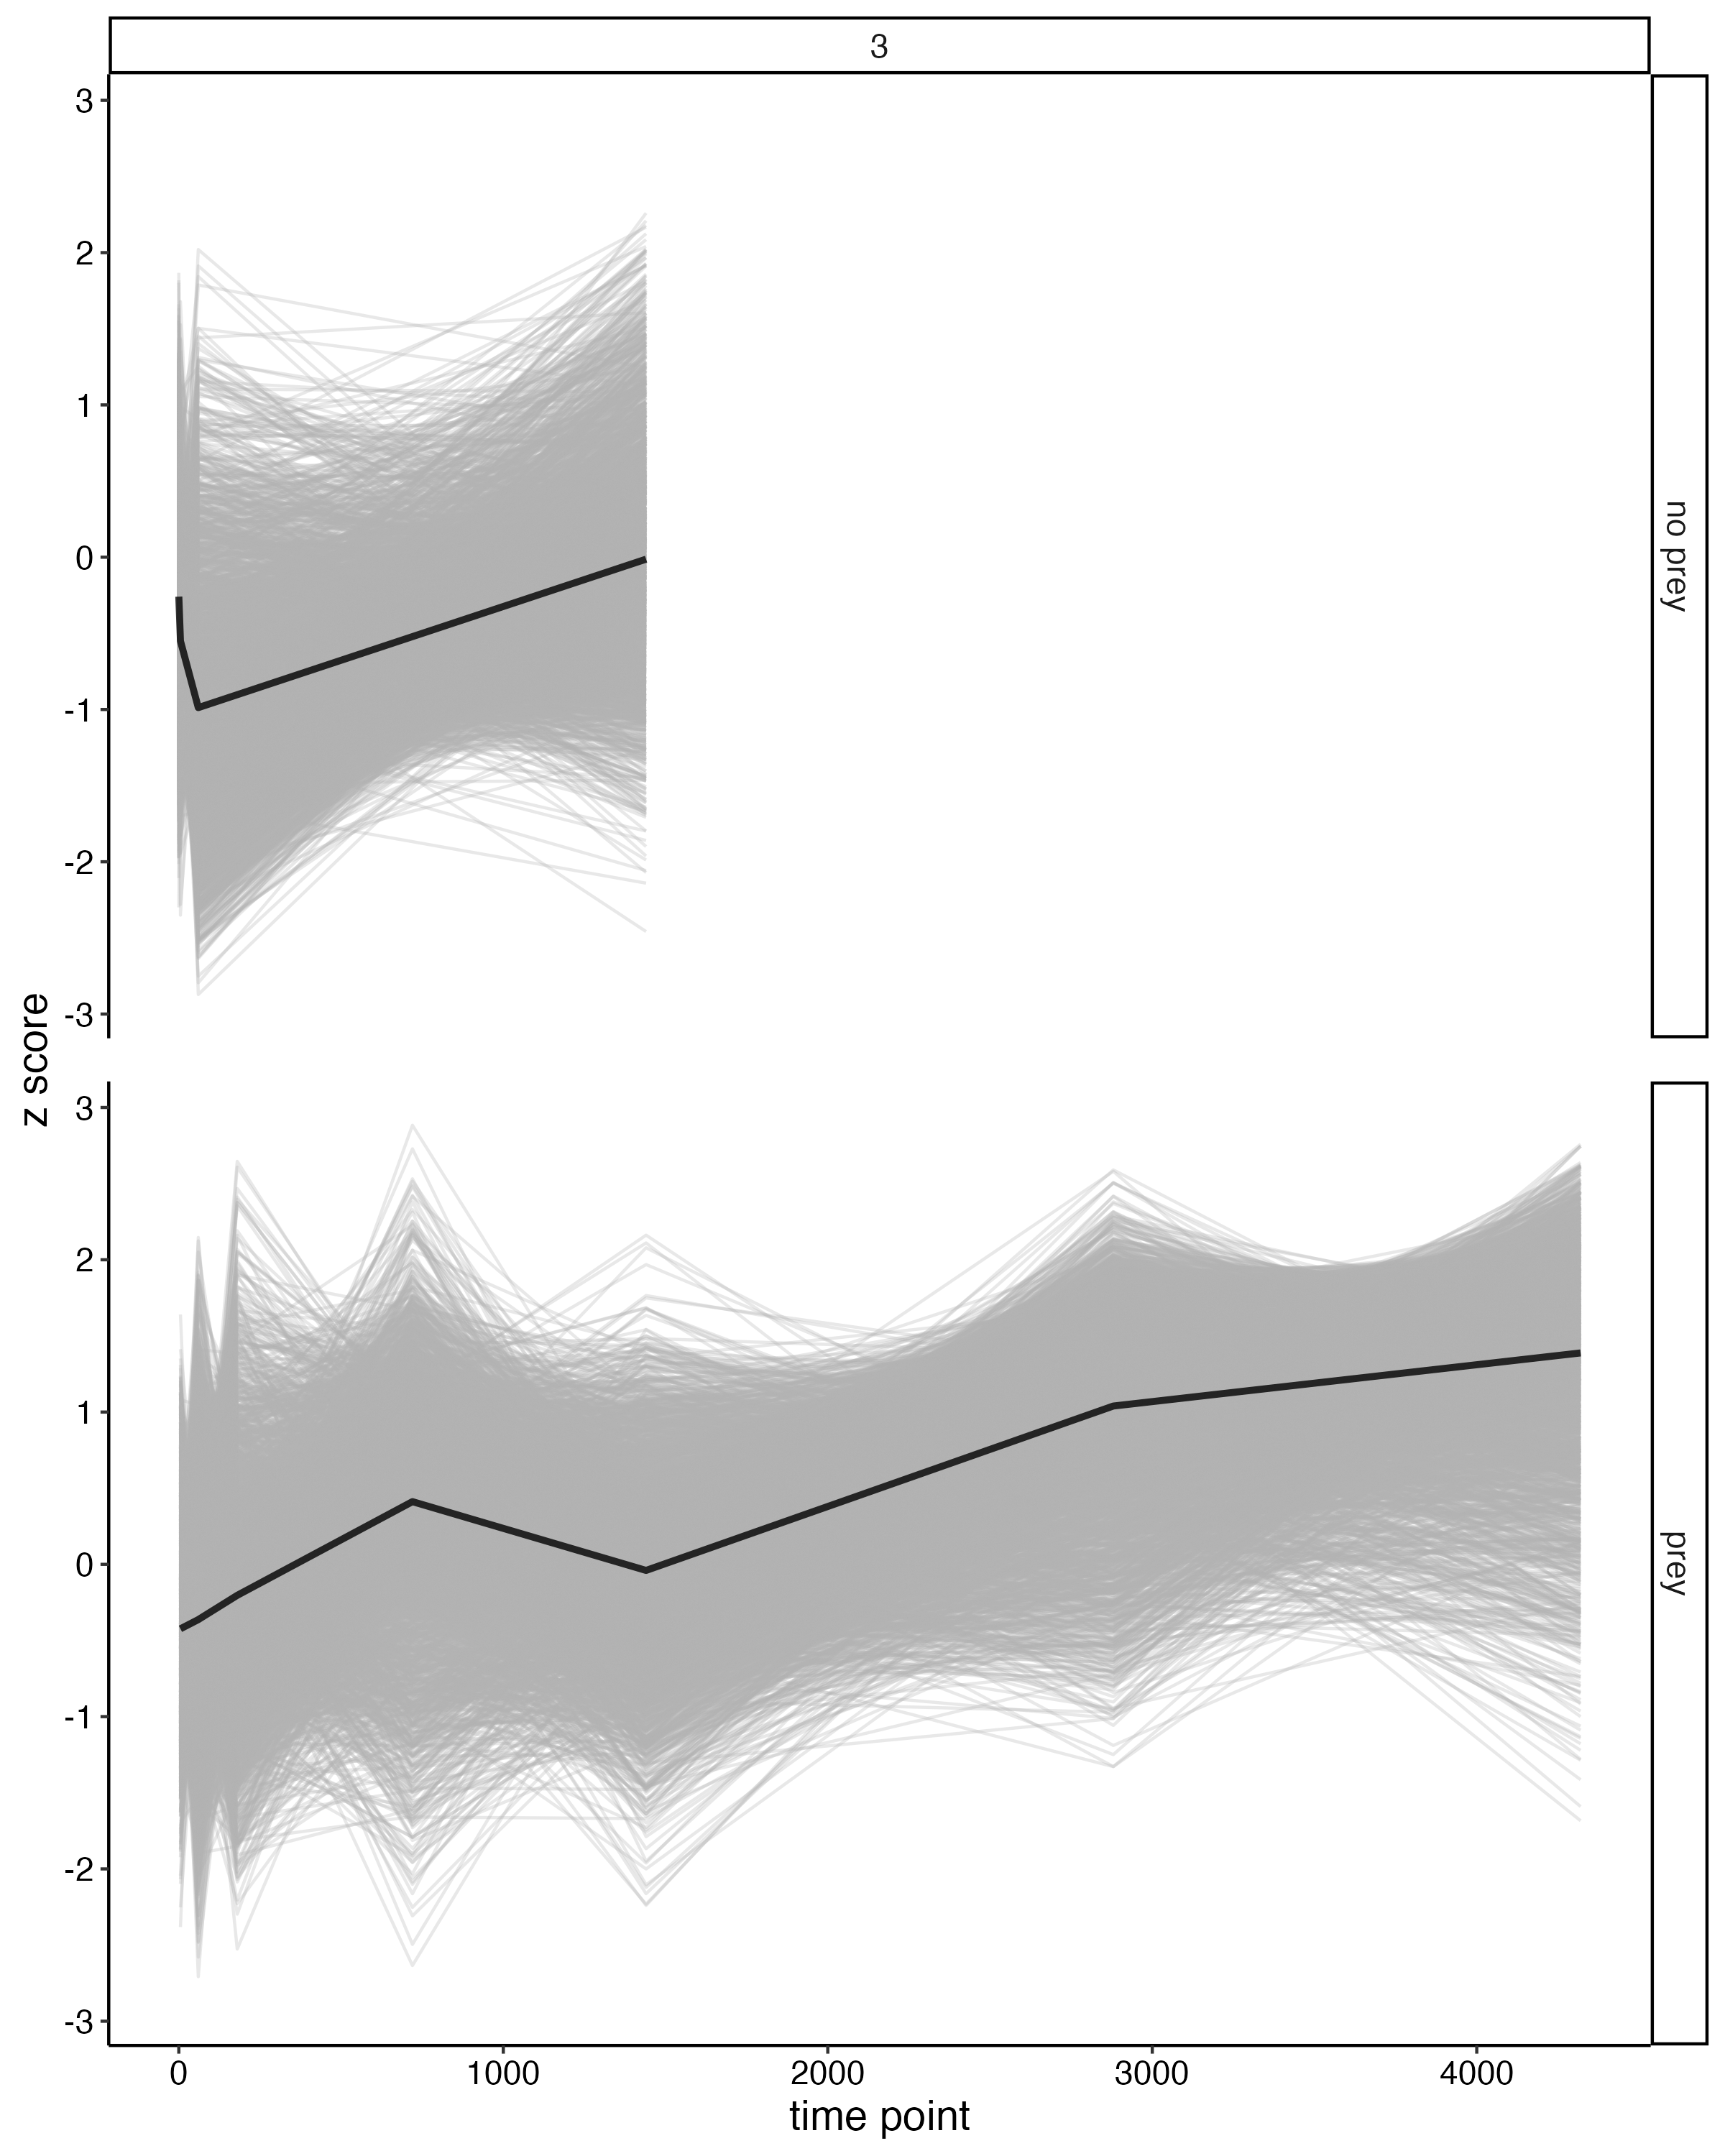
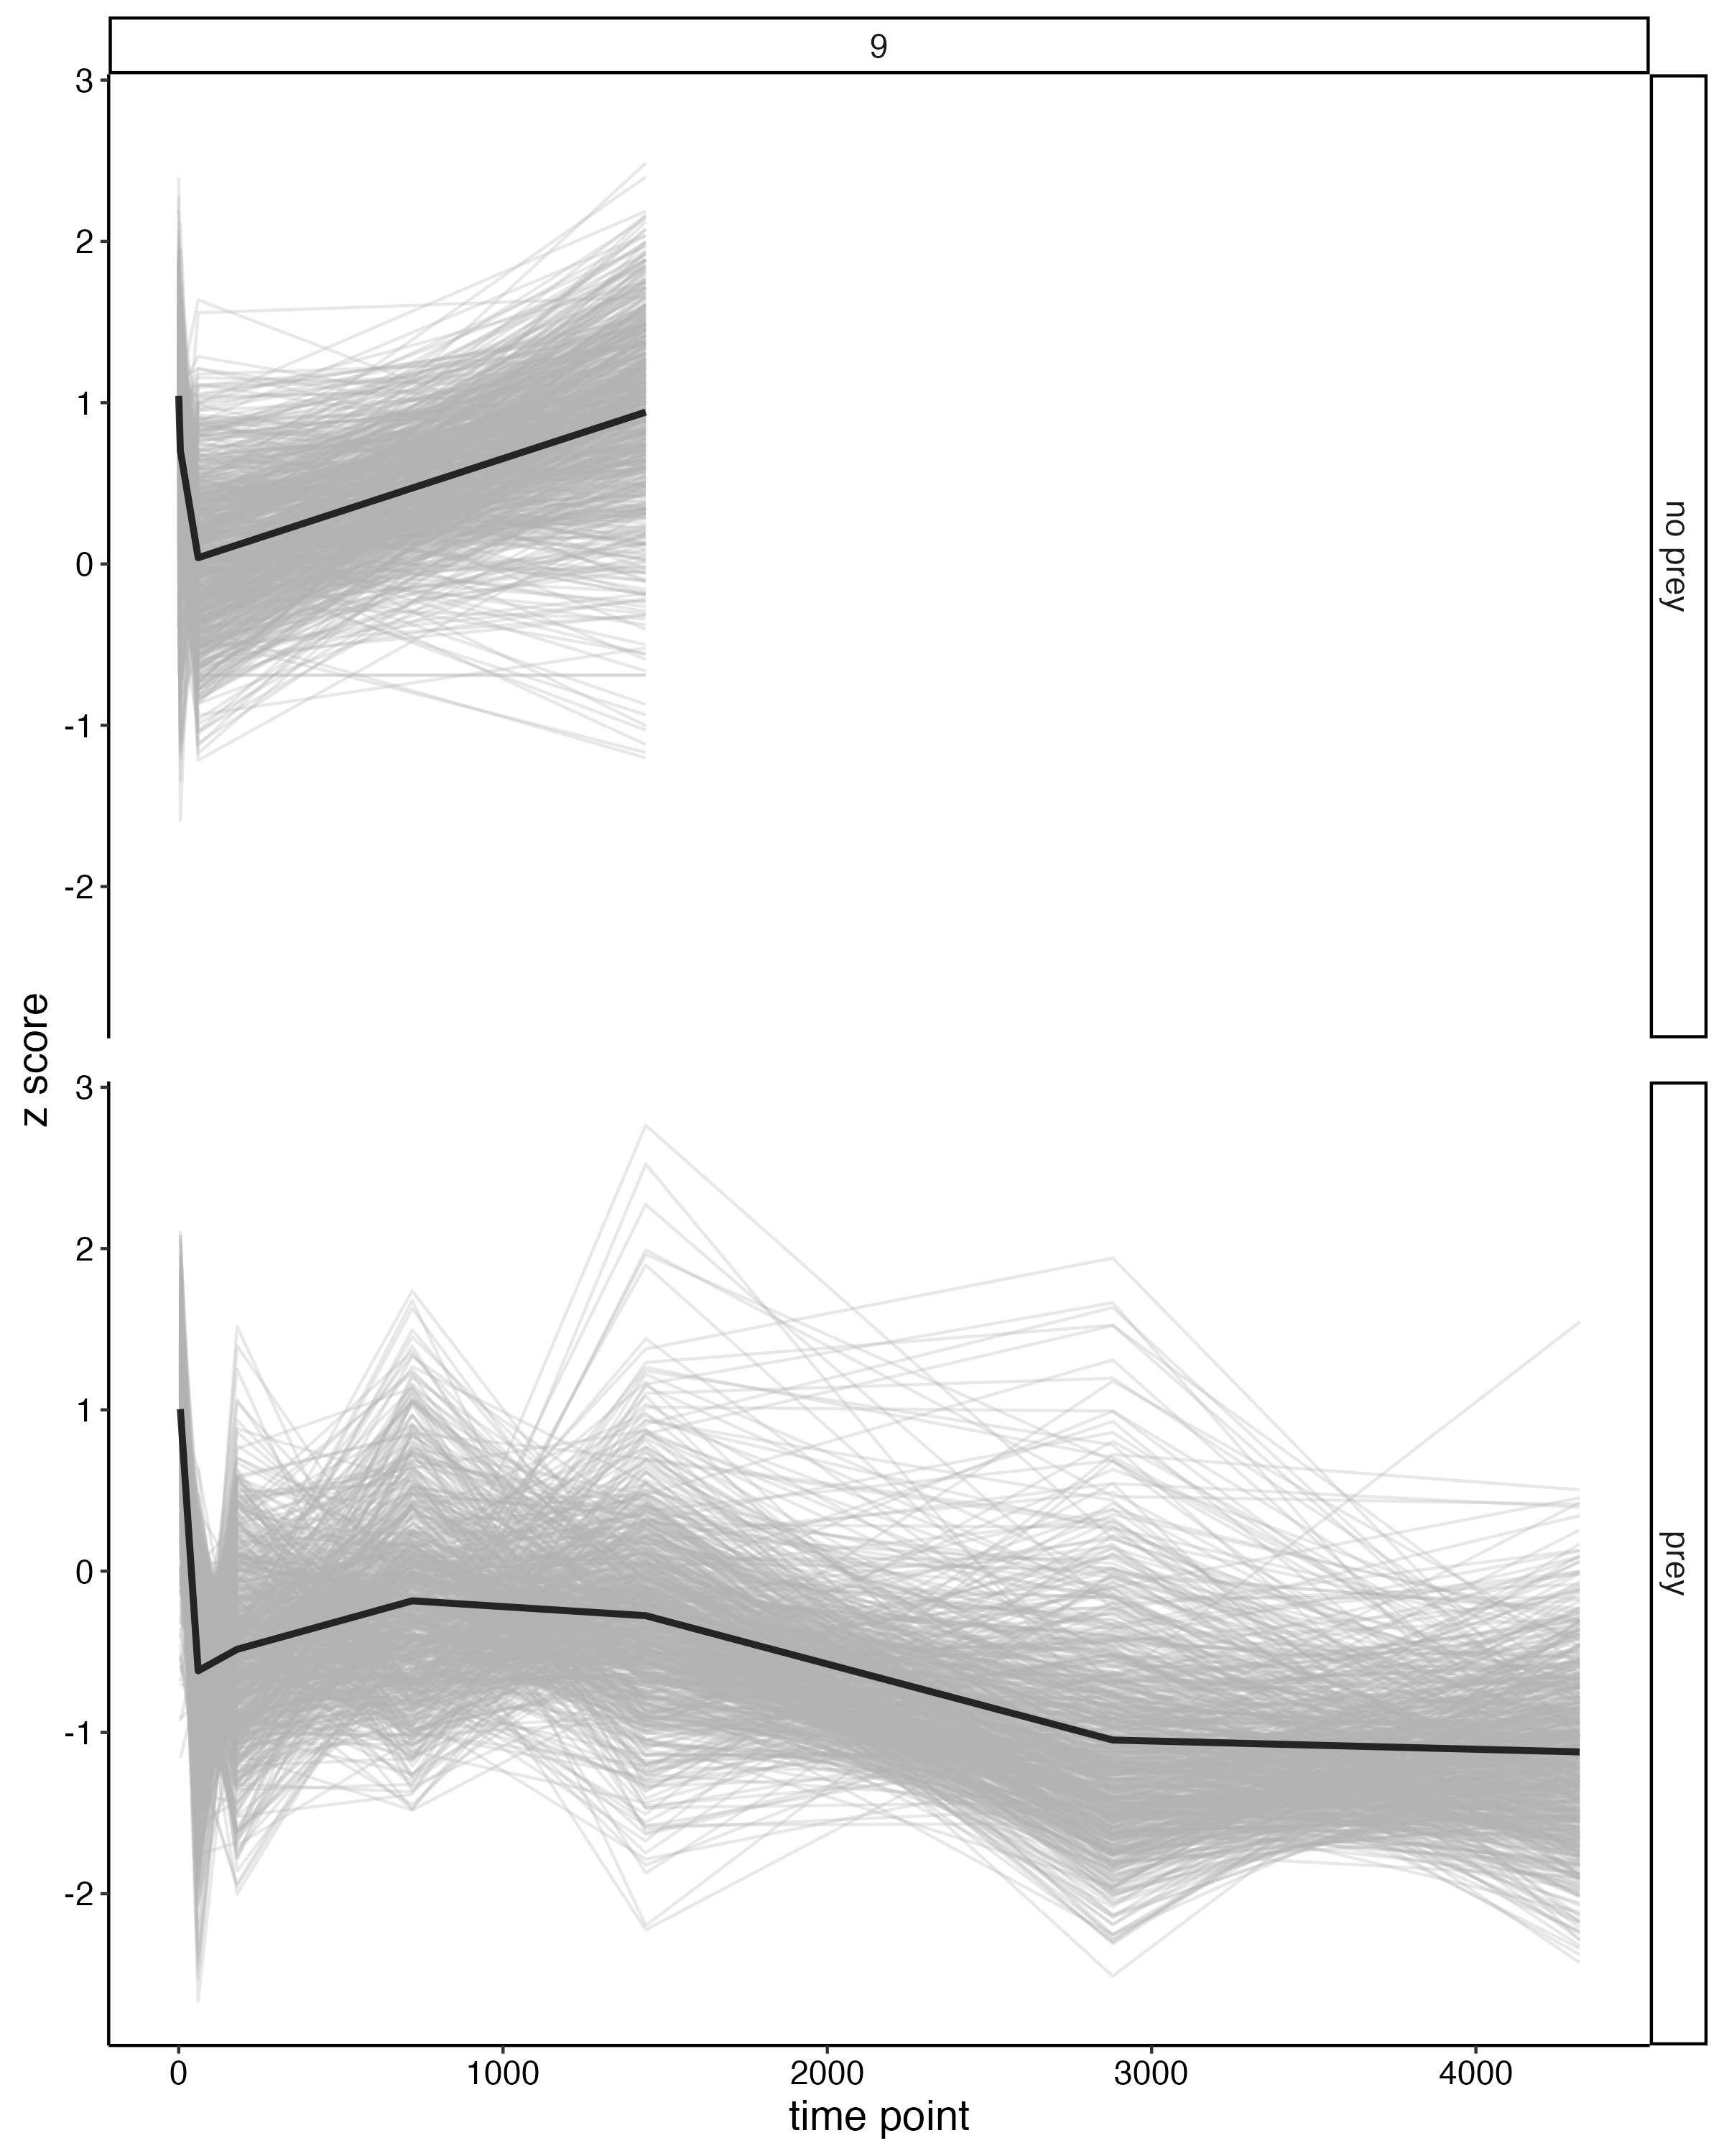
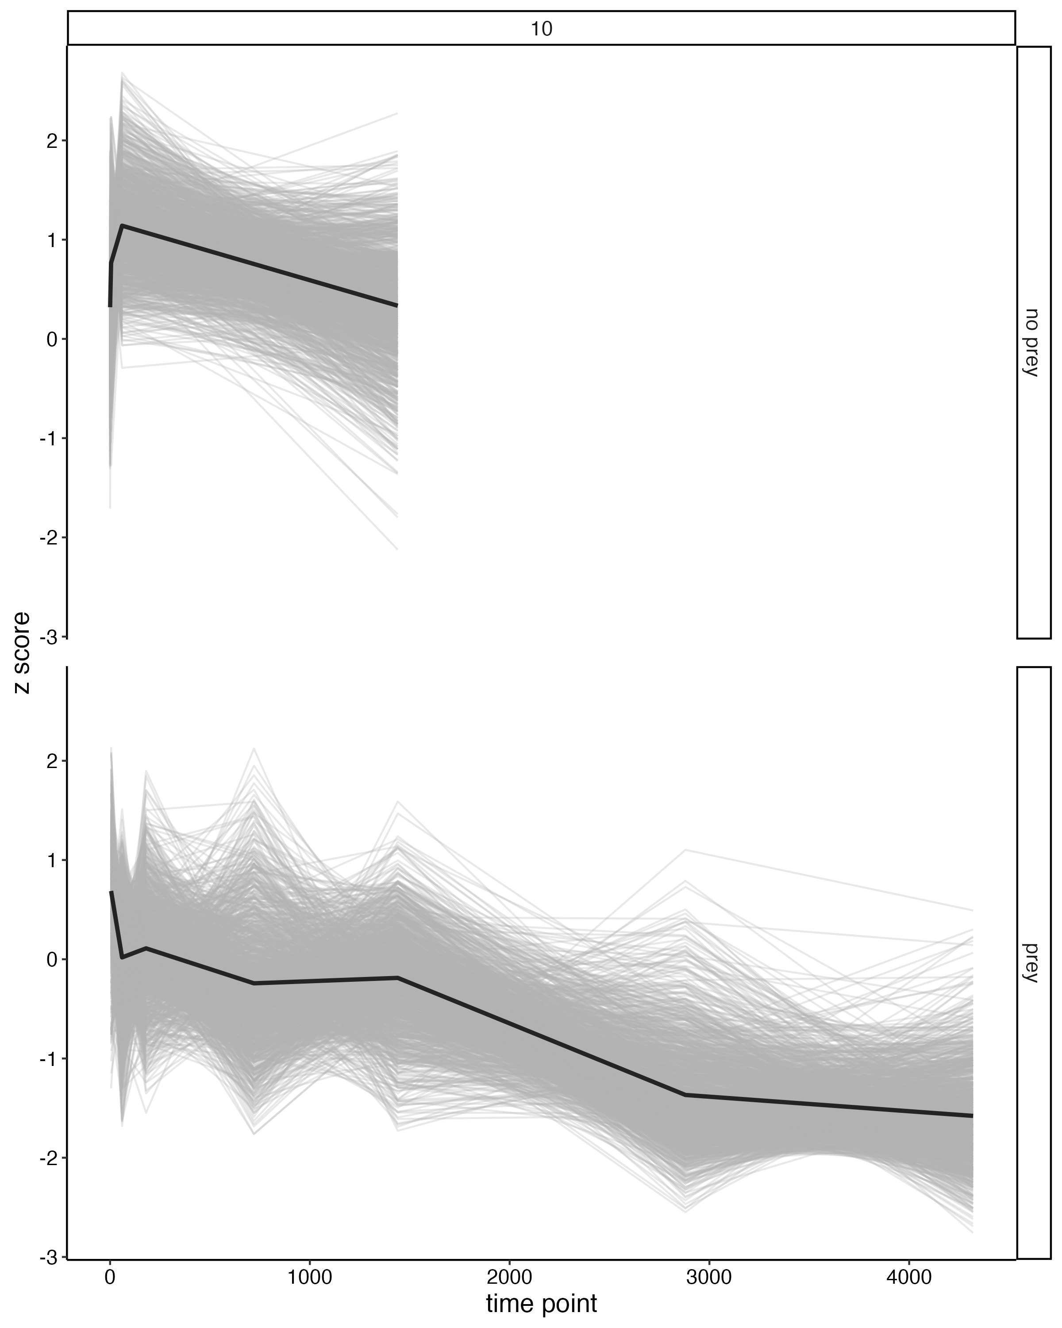
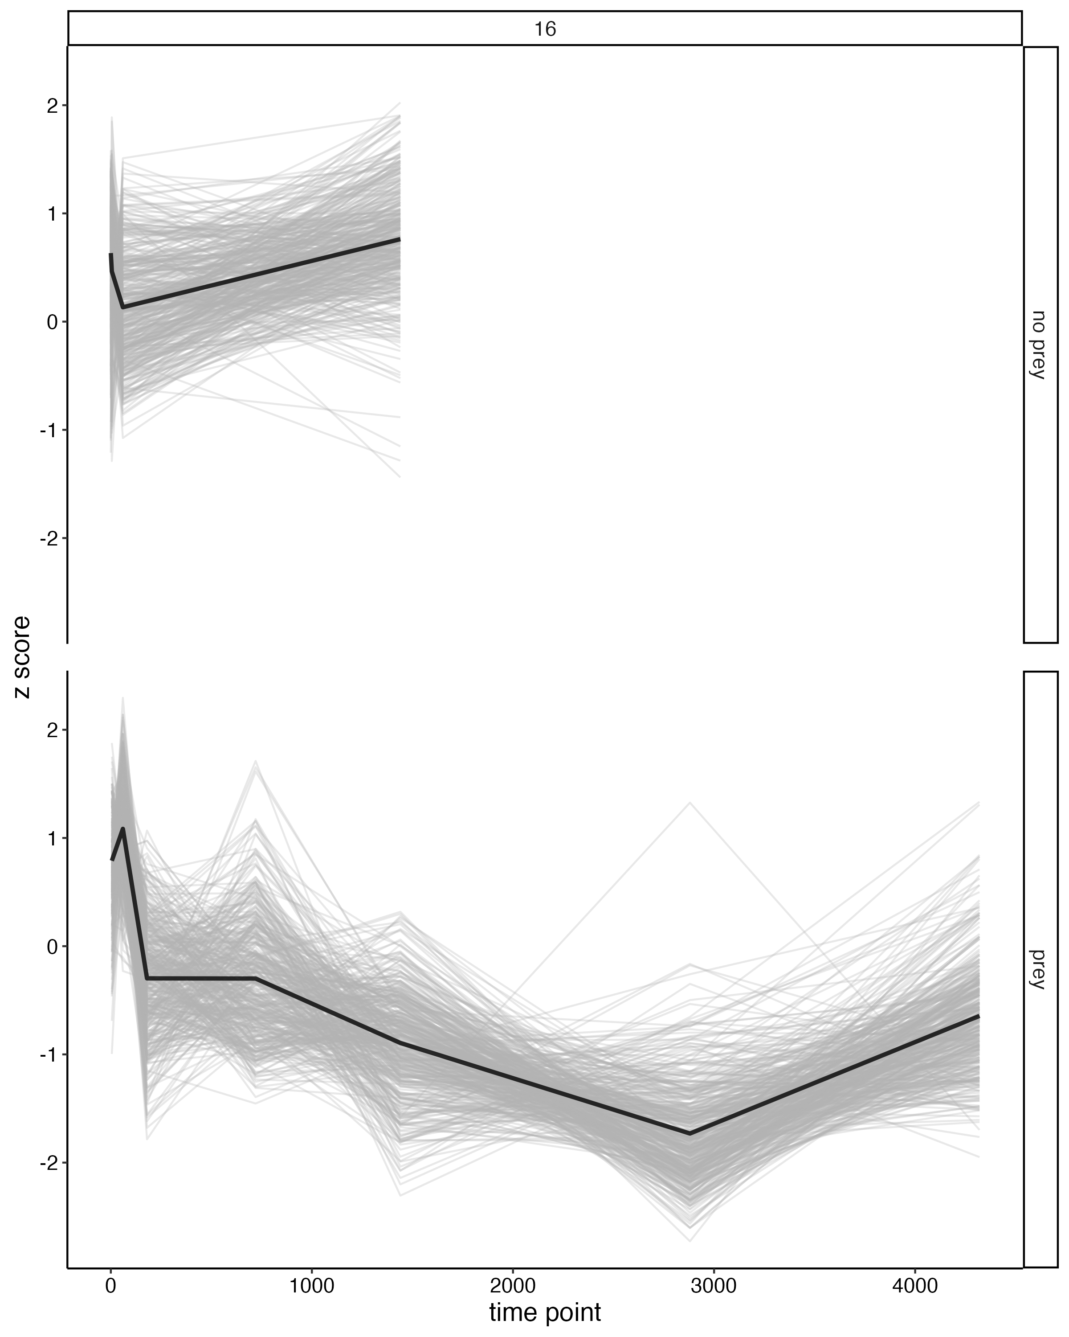
1 hr time point
Corresponds with 8 modules: 2,3,4,6,7,9,10,16
71 upregulated in no prey –
module 3,6,7,9,10
103 upregulated in prey module 2,3,4,16

Slide 4
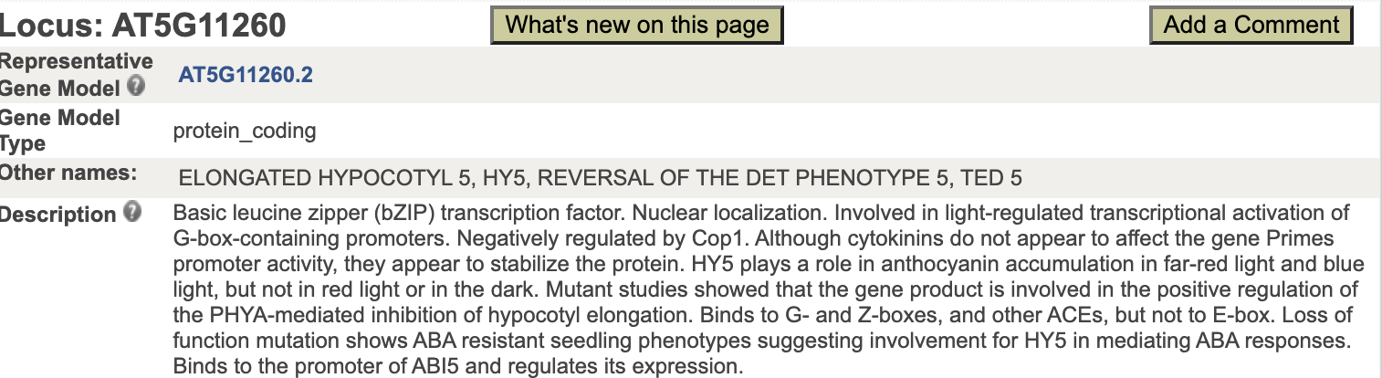
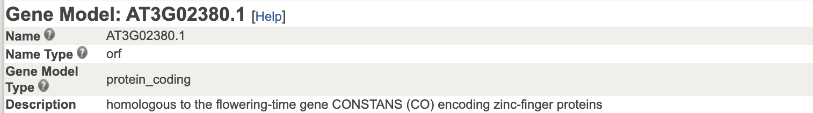
Prey Vs. No Prey 24 hr time point
151 DEG’s 5 modules: 2,3,4,6,10
2 upregulated in no prey –
module 2 and 6

Slide 5
Prey Vs. No Prey 24 hr time point
151 DEG’s 5 modules: 2,3,4,6,10
2 upregulated in no prey –
module 2 and 6
149 upregulated in prey –
module 3,4,10
Enzymes: 1 chitinase, 1 lipase, 1 peroxidase,
1 protease, 4 phosphatases, 3 peptidases

